Slide 1
Anomaly Detection in Railway Bridges Using Imaging Techniques

Slide 2
Presented by
JANNATUS SAKIRA KHONDAKER
ID-20301468
TEAM NO. - 10
RA - SANIA AZHMEE BHUIYAN
ST - MEHNAZ ARA FAZAL

Slide 3
About the Project
The goal of this work is to show that machine learning and imaging techniques can be successfully applied to classification problems in apparently unrelated fields such as physical structures monitoring even when the monitoring sensors do not provide any
visual output.
The paper addresses the problem of monitoring the structural health of railway bridges, which is very important for safety and maintenance purposes.

Slide 4
Components
Summary
Limitations
Synthesis

Slide 5
SUMMARY

Slide 6
Motivation
In this paper, a method which adapts image analysis tools and methodologies, taken from the field of computer vision, and applies them to the monitoring signals of a railway bridge is used.
This method correctly identifies changes in the structural health of the bridge with very high precision, thus providing -
Better
Simpler
General alternative

Slide 7
Contribution:
Here it is shown that this IADE framework has high accuracy on the proposed dataset, with results similar to those obtained with classical methods of structural engineering while being far more general and easier to implement.

Slide 8
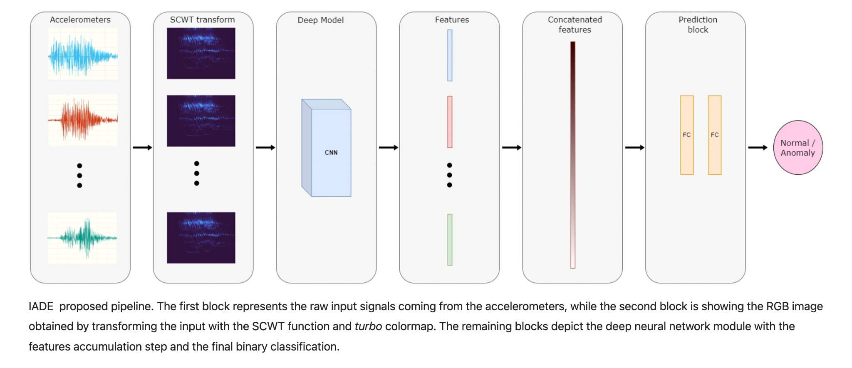
Methodology:
jknl
Transformation of the accelerometer data. Deep neural network anomaly prediction

Slide 9
CONCLUSION
100%
75%
50%
25%
0%
The paper evaluates the proposed method on a real dataset collected from a railway bridge in Belgium, before, during, and after retrofitting.
ACCURACY(97.3%)
PRECISION(98.2%)
RECALL(96.4%)

Slide 10
LIMITATIONS

Slide 11
FIRST LIMITATION
SECOND LIMITATION
THIRD LIMITATION
The method relies on the availability and quality of the accelerometer data, which may not be always feasible or consistent in different bridges or environments.
The method does not provide a physical interpretation of the output of the Synchrosqueezing Continuous Wavelet Transform
The method relies on the availability and quality of the accelerometer data, which may not be always feasible or consistent in different bridges or environments.

Slide 12
Synthesis
The paper demonstrates the effectiveness and generality of the method on a real case study, and suggests some possible extensions and improvements for future work.

Slide 13
Thank You!

